Slide 1
Automating Apache Traffic Control Environment Deployments with Ansible
June, 20th, 2019

Slide 2





BIO
Jonathan Gray
Comcast Content Delivery Network Team
Site Reliability Engineer 4
Twitter : @jhg03a
GitHub : @jhg03a
traffic-control-cdn.slack.com : @jhg03a
jhg03a@apache.org
https://about.twitter.com/en_us/company/brand-resources.html
https://github.com/logos
https://slack.com/media-kit https://commons.wikimedia.org/wiki/File:Antu_mail-folder-sent.svg

Slide 3

What is a Content Delivery network?
CDN
Caching transport
https://www.pexels.com/photo/white-clouds-2217366/

Slide 4


What is a Content Delivery network?
Client
Requestor of content
CDN
Caching transport
Origin
Webserver
https://www.pexels.com/photo/woman-using-computer-in-office-2084974/ https://www.pexels.com/photo/white-clouds-2217366/ https://www.pexels.com/photo/interior-of-office-building-325229/

Slide 5
What is a Content Delivery network?
Client
Requestor of content
CDN
Caching transport
Origin
Webserver
www.example.com
origin.example.net
https://www.pexels.com/photo/woman-using-computer-in-office-2084974/ https://www.pexels.com/photo/white-clouds-2217366/ https://www.pexels.com/photo/interior-of-office-building-325229/

Slide 6

How does a CDN work?
https://www.flickr.com/photos/mil8/380092713

Slide 7
Benefits of a Content Delivery Network
Clients
Reduced latency
Faster downloads

Slide 8
Benefits of a Content Delivery Network
Clients
Reduced latency
Faster downloads
Origin owners
Reduced “hardware” costs
Reduced network costs
Improved user experience

Slide 9
Benefits of a Content Delivery Network
Clients
Reduced latency
Faster downloads
Origin owners
Reduced “hardware” costs
Reduced network costs
Improved user experience
Internet Service Providers
Reduced interconnect usage
Reduced backhaul usage

Slide 10
CDN Anatomy

Slide 11
Apache Traffic Control
Web-based User Interface for CDN Operations
Intelligent Routing of CDN Client Requests
Business logic API Layer
for CDN Operations
Health Evaluation of CDN Caches
Collection, Aggregation, Transformation for CDN Metrics
Experimental Caching
Proxy Server
Apache Traffic Server
Configuration Management

Slide 12




Apache Traffic Server
Apache Traffic Control
3rd party Databases
RiakKV
Used for Secure CDN Tenant Data
PostgreSQL
Used for CDN Configuration and State Data
Caching Proxy
Server
InfluxDB
Timeseries Database used for CDN Metrics
https://trafficserver.apache.org/press.html
https://riak.com/design-assets-hub/ https://wiki.postgresql.org/wiki/Logo https://commons.wikimedia.org/wiki/File:Influxdb_logo.svg

Slide 13
CDN Environments

Slide 14
Status
As of 8/24/19, the Ansible-based lab work is in a pull request:
https://github.com/apache/trafficcontrol/pull/3585
Likewise, the fake test origin used is in pull request:
https://github.com/apache/trafficcontrol/pull/3567

Slide 15
Mission
Replicate and automate the creation of a number of production clone environments
Facilitate the maintenance of a minimally viable, but useful, test dataset
Solve in such a manner that others can modularly adopt and integrate the components they desire in their implementations

Slide 16
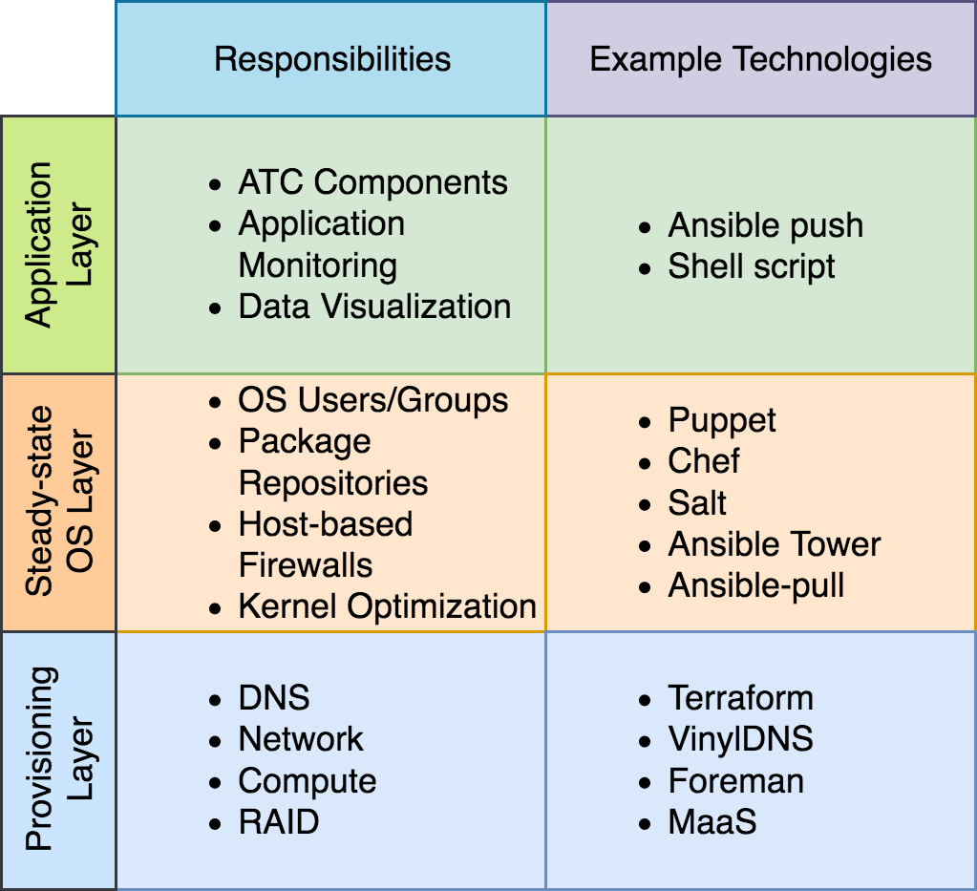
Environment Abstraction Layers
Not CDN-out-of-the-box
Every abstraction layer comes at a price; some are more expensive than others. Lower costs through reuse of existing tools/skillsets.
https://github.com/apache/trafficcontrol/pull/3585
Notes:
Don’t read bullets

Slide 17
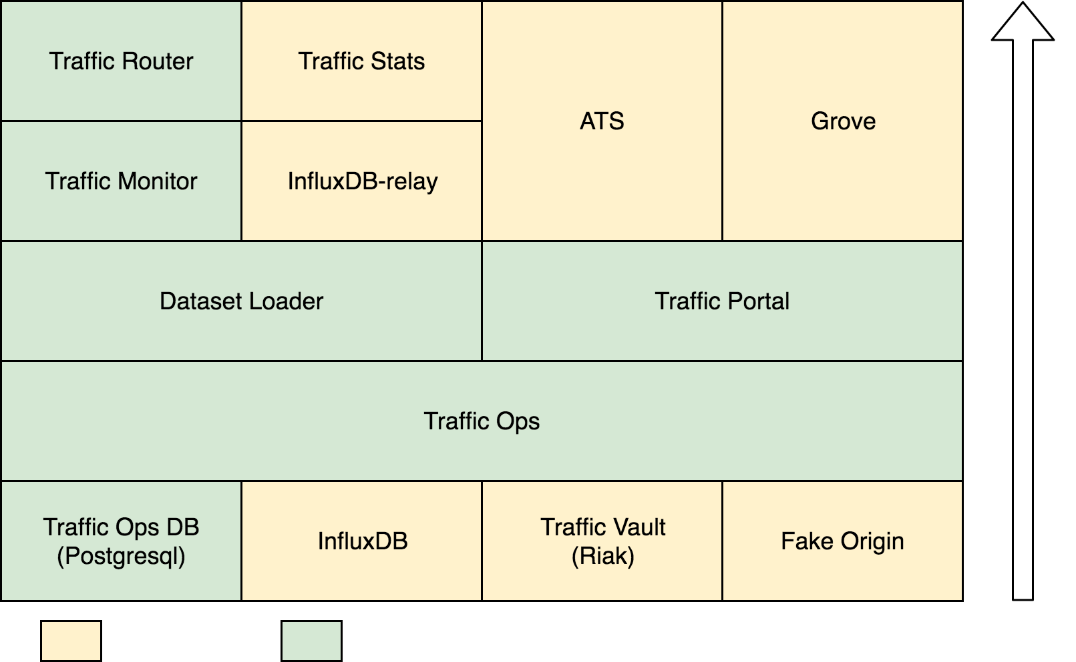
CDN Lab Components
ATC Component installation order
Not all ATC Components are strictly required, but are become important at some scales or desired functionality.
Due to application stack dependencies care should be taken with regard to order and parallelization of installation.
https://github.com/apache/trafficcontrol/pull/3585

Slide 18
What is an Ansible Role?

Slide 19
ATC Component Ansible Playbook Pattern
Load Environment-based Variables
Implementation Specific Driver
Load environment-based variables
Implementation-specific Pre-tasks
Generic Core role
Implementation-specific Post-Tasks
Generic Core

Slide 20
Variable Precedence
From most to least important
extra vars (always win precedence)
set_facts / registered vars
include_vars
include params
role (and include_role) params
task vars (only for the task)
block vars (only for tasks in block)
role vars (defined in role/vars/main.yml)
play vars_files
play vars_prompt
play vars
host facts
playbook host_vars/*
inventory host_vars/*
inventory file or script host vars
playbook group_vars/*
inventory group_vars/*
playbook group_vars/all
inventory group_vars/all
inventory file or script group vars
role defaults
Used in lab
https://gist.github.com/ekreutz/301c3d38a50abbaad38e638d8361a89e

Slide 21
Dataset Loader Role

Slide 22
Blending variable data
Implementation Specific driver playbook
- name: Deploy the Initial ATC Dataset
import_role:
name: dataset_loader
vars:
dl_shallow_czf_url: http://examplewebserver.local/czf.json

Slide 23
Blending variable data
Implementation Specific driver playbook
- name: Deploy the Initial ATC Dataset
import_role:
name: dataset_loader
vars:
dl_shallow_czf_url: http://examplewebserver.local/czf.json
dl_to_url: "{{ to_url }}"

Slide 24
Blending variable data
Implementation Specific driver playbook
- name: Deploy the Initial ATC Dataset
import_role:
name: dataset_loader
vars:
dl_shallow_czf_url: http://examplewebserver.local/czf.json
dl_to_url: "{{ to_url }}"
dl_allow_ip4: "{{ (['127.0.0.1','192.168.100.0/24'] + (groups['traffic_monitor'] | map('extract', hostvars, ['ansible_default_ipv4', 'address']) | list)) | join(',') }}"

Slide 25
Blending variable data
Dataset_loader Generic Core defaults/main.yml
# TO CDN
dl_ds_merged_cdns: "{{ dl_ds_default_cdns }}"
dl_ds_default_cdns:
MKGA:
name: Kabletown2.0
# TO Types
dl_ds_merged_types: "{{ dl_ds_default_types }}"
dl_ds_default_types:
- name: INFRA_LOC
description: Generic Infrastructure Logical Location

Slide 26
Blending variable data
Implementation Specific driver playbook
- name: Deploy the Initial ATC Dataset
import_role:
name: dataset_loader
vars:
dl_shallow_czf_url: http://examplewebserver.local/czf.json
dl_to_url: "{{ to_url }}"
dl_allow_ip4: "{{ (['127.0.0.1','192.168.100.0/24'] + (groups['traffic_monitor'] | map('extract', hostvars, ['ansible_default_ipv4', 'address']) | list)) | join(',') }}"
dl_ds_merged_cdns: "{{ dl_ds_default_cdns | combine(dl_ds_test_cdns) }}"
dl_ds_test_cdns:
AnotherCDN:
name: Another.Test.CDN
dl_ds_merged_types: "{{ dl_ds_default_types + dl_ds_private_types }}"
dl_ds_private_types:
- name: INFLUX_RELAY
description: Influx Relay Server type
Dataset_loader Generic Core defaults/main.yml
# TO CDN
dl_ds_merged_cdns: "{{ dl_ds_default_cdns }}"
dl_ds_default_cdns:
MKGA:
name: Kabletown2.0
# TO Types
dl_ds_merged_types: "{{ dl_ds_default_types }}"
dl_ds_default_types:
- name: INFRA_LOC
description: Generic Infrastructure Logical Location

Slide 27
Sample Lab Structure

Slide 28
Ansible Structure
Getting Going
Create your fork of ATC
Decide how you’re going to manage the Generic Core Roles Versioning
Start building your implementation-specific driver playbooks
Rename or copy the sample.lab directory to whatever you like
Adjust lab environment directory runners and variables to match what’s desired
<repo root>/infrastructure/ansible
├── dynamic.inventory
├── roles
├── < lab name, i.e. sample.lab >
├── templates
├── sample playbooks…
└── implementation-specific driver playbooks

Slide 29
Lab Structure
Each lab can share the same implementation specific driver playbooks and generic core roles.
<repo root>/infrastructure/ansible/sample.lab
├── ansible
│ ├── vars.yml
│ └── vault
├── inventory
│ ├── provisioning.inventory
│ └── component.inventory
├── out
│ └── ssl
│ └── ssl certs & keys
├── ansible-playbook.sh
├── ansible.cfg
├── Ansible.Dockerfile
├── docker-compose.yml
├── gilt.yml
└── manual.run.sh

Slide 30
Secrets

Slide 31
Environment Abstraction Layers
Contracts
Provisioning layer must create a compatible Ansible inventory
Steady-state OS Layer may include sentinel state check for completion
Most likely the steady-state OS layer should also contain common tasks for all ATC components such as SSL PKI creation and distribution (included sample in repository)
https://github.com/apache/trafficcontrol/pull/3585

Slide 32
Sample Provisioning Contract
[atsmid]
cdn-atsmid-01.samplelab.kabletown.invalid ansible_host=192.168.100.145 cdn=MKGA component=atsmid
cdn-atsmid-02.samplelab.kabletown.invalid ansible_host=192.168.100.161 cdn=MKGA component=atsmid
[fakeorigin]
cdn-fo-01.samplelab.kabletown.invalid ansible_host=192.168.100.104 cdn=MKGA component=fakeorigin ds_names=ds0-cdn-fo-01.samplelab.kabletown.invalid,ds1-cdn-fo-01.samplelab.kabletown.invalid,ds2-cdn-fo-01.samplelab.kabletown.invalid

Slide 33
Versioning

Slide 34
Relationships
Repository
Application
ANSIBLE ROLE
Version
Ansible Galaxy
ROLE
TRAFFIC PORTAL
1.0.0
ATC
ROLE
TRAFFIC OPERATIONS
1.2.0
ROLE
TRAFFIC ROUTER
2.1.0
ATC Ansible Lab
TRAFFIC PORTAL
ATC
TRAFFIC OPERATIONS
3.0.1
TRAFFIC ROUTER

Slide 35
Versioning Solutions
Keep what’s in your fork and modify in place
Extract roles from build/release artifact source tarball
Gilt
https://github.com/metacloud/gilt
However you go about it, what’s in your roles directory on disk at runtime is what matters

Slide 36
GILT
Sample gilt.yml:
- git: git@github.com:apache/trafficcontrol.git
version: master
files:
- src: infrastructure/ansible/roles/ats
dst: ../roles/ats
- src: infrastructure/ansible/roles/dataset_loader
dst: ../roles/dataset_loader
https://github.com/metacloud/gilt

Slide 37
Running the deploy

Slide 38
Performance
Component | Deployment Time* | Component | Deployment Time*
TODB | 1m 18s | Traffic Monitor | 45s
Traffic Vault | 4m 12s | Traffic Router | 2m 21s
InfluxDB | 30s | ATS | 2m 6s
Fake Origin** | 8m 1s | Grove | 1m 4s
Traffic Ops | 10m 24s | Influx-relay | 31s
Traffic Portal | 47s | TrafficStats | 21m 31s
Dataset Loader | 34m 50s
Total time to deploy*
2h 17m
* Times measured as of 8/24/19 and include Additional Comcast overhead
** Includes time to render Sample Assets

Slide 39
Operational Bonuses

Slide 40
TO_API role

Slide 41
Dynamic Inventory script
Sample ad-hoc usage:
# TO_USER=username TO_PASSWORD=password TO_URL=to.cdn.samplelab.invalid ansible –i infrastructure/ansible/dynamic.inventory/TO.py all –m ping

Slide 42
Dynamic Inventory script
Sample Ansible groups for patterns:
Simple Hostname: atsedge*
Status: server_status|OFFLINE
Type: server_type|EDGE
CDN Name: server_cdnName|Kabletown2.0
Profile: server_profile|ATS_EDGE_7
Cachegroup: cachegroup|edge_east
Parent Cachegroup: parentCachegroup|mid_east
Secondary Parent Cachegroup: secondaryParentCachegroup|mid_west

Slide 43

Takeaways
Build out your implementation’s provisioning & steady-state layers with technologies you already use.
Use the provided Ansible roles to abstract the complexity of each CDN component in your deployment playbooks.
Create and customize each individual environment’s configuration using the flexibility of Ansible and samples provided.
Run one script, ./manual.run.sh, to throw away your old lab environment and rebuild it from the ground up; formatted drives, new instances, and all without humans.
Jonathan Gray
Twitter : @jhg03a
GitHub : @jhg03a
traffic-control-cdn.slack.com : @jhg03a
jhg03a@apache.org
https://unsplash.com/photos/R4WCbazrD1g

